Slide 1
Data Pipeline

Slide 2
Data source and files
Data file | Data source
customers.csv | AWS RDS
orders.csv | AWS RDS
returns.csv | AWS RDS
transactions.csv | AWS RDS
customer_review.csv | AWS S3
products.json | MongoDB Atlas cluster

Slide 3
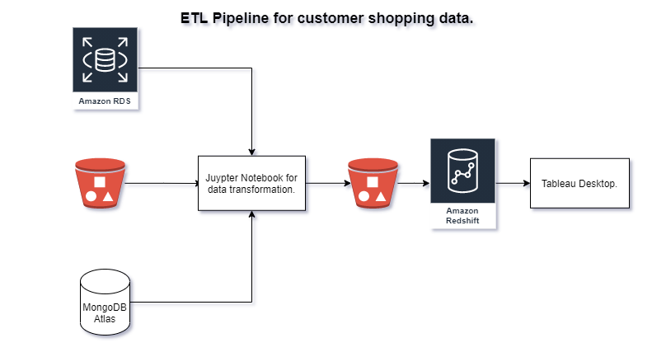

Slide 4
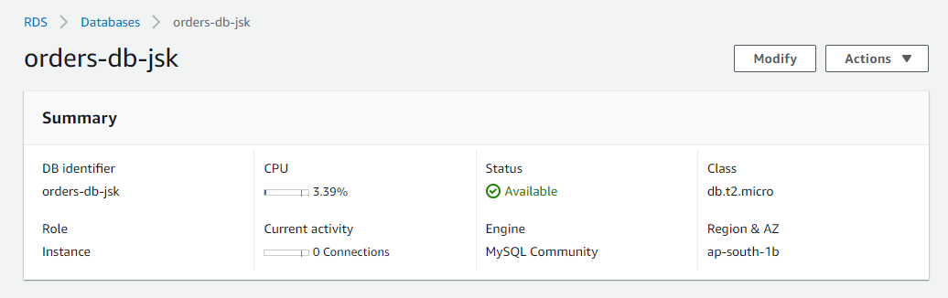
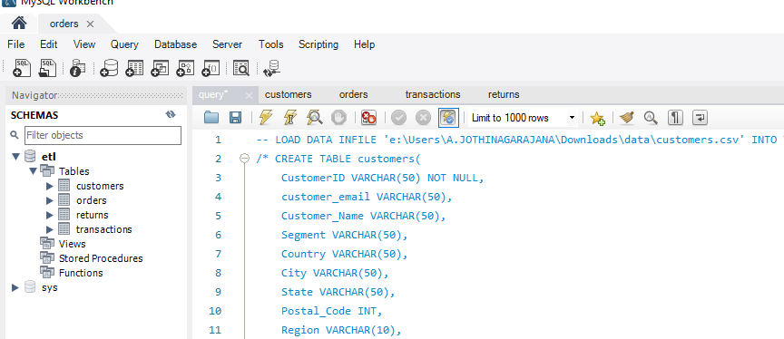
In AWS free tier account, created a RDS instance with MySQL engine.
Connected to the AWS RDS
Instance using MySQL community as client. Then, created a new database called ‘etl’ then imported the CSV files as tables into the database.

Slide 5
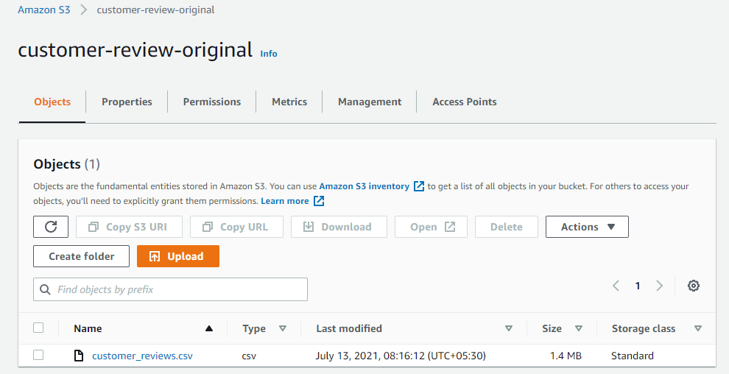
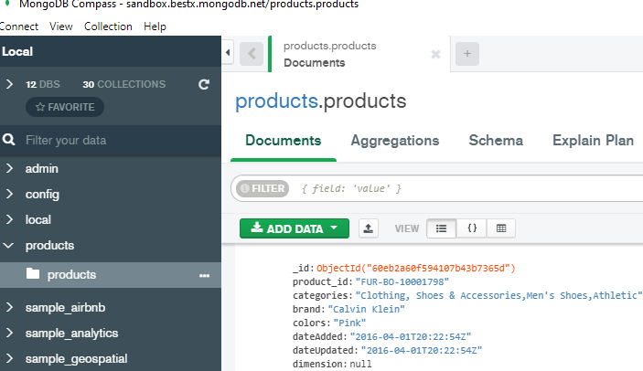
Uploaded ‘customer_review.csv’ file
Into a AWS S3 bucket.
Created a MongoDB
Atlas cluster and added the
‘products.json’ file as collection in
the cluster.

Slide 6
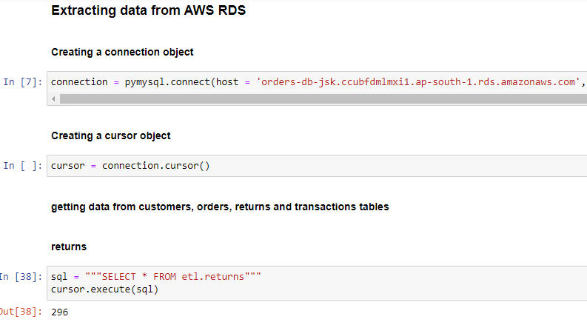
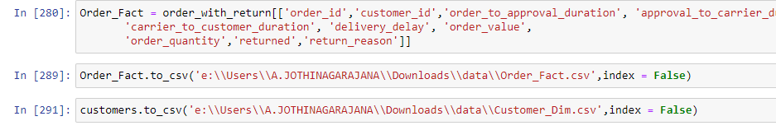
Snapshots of transformation
Script.
*The full script can
be found along with
the presentation

Slide 7
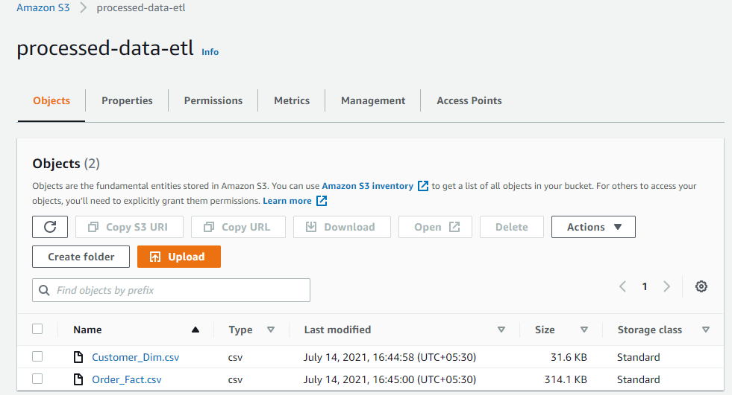
The transformed data are stored as csv files in AWS S3

Slide 8
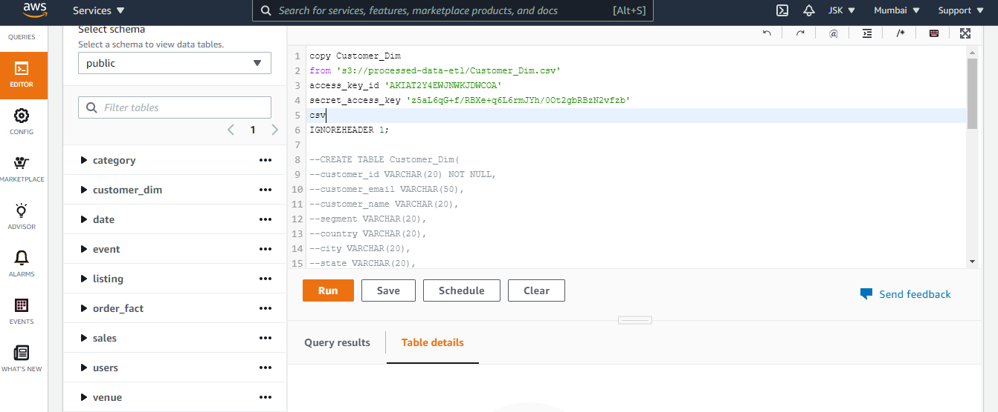
The transformed CSV files stored in S3 are copied into the Amazon Redshift cluster using copy command.

Slide 9
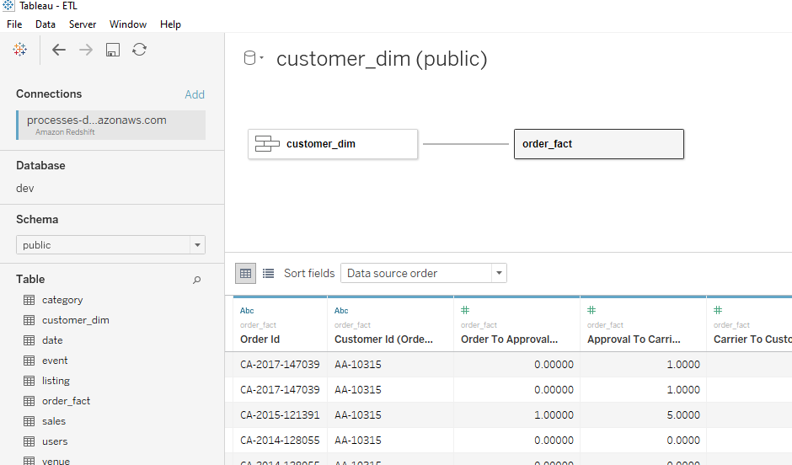
Connected to Amazon Redshift using ODBC driver to Tableau.

Slide 10
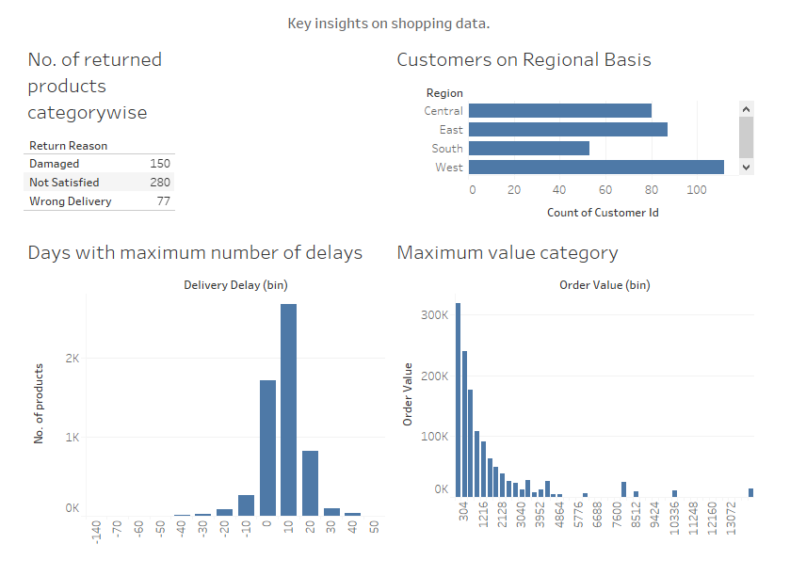
Some key insights are derived from the transformed data in Tableau.

